Slide 1

DTX OPERATING MODEL · SALES PACK
ICB COMMISSIONERS
Easy buying as the North Star.
A portfolio operating model that means three workstreams under one framework, six weeks from brief to call-off instead of eighteen months, and the year you do not lose to procurement attrition.
Digital Therapeutics · HomeTest · HealthStore · HealthSync

Slide 2
THE REALITY
A year you do not have. A detection gap and an admissions curve you do.
A typical ICB commissioning brief in 2026 has a cardiovascular detection gap, rising COPD admissions, and a high-risk monitoring cohort that needs something better than the current annual review.The clinical case is settled. What is missing is the time, the headcount, and the procurement architecture to stand up three separate digital workstreams against three separate timelines.The old way is three procurements, three IG assessments, three sets of MI. Eighteen to twenty-two months minimum.The operating model is the answer to that maths.
DTx Operating Model · Sales pack · Commissioner
2 of 12

Slide 3
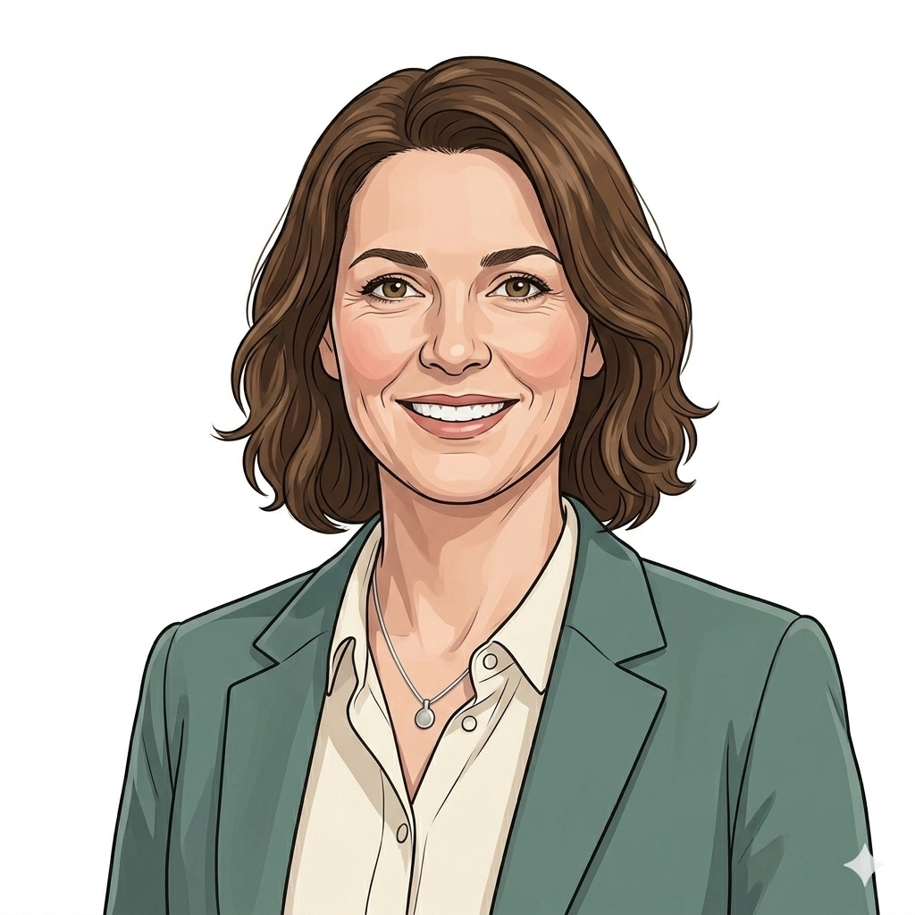
MEET SARAH
Population of three hundred thousand. Cardiovascular detection gap, COPD admissions rising, high-risk cohort needing closer monitoring.
“I have got a gap I can see on the dashboard, money on the table and twelve months to show movement. What I have not got is the headcount to run three separate procurements end to end.”
SARAH · ICB COMMISSIONER, POPULATION HEALTH
DTx Operating Model · Sales pack · Commissioner
3 of 12

Slide 4
ONE FRONT DOOR
Three product overlays. One national framework. Suppliers already admitted, prices already capped, terms already negotiated.
HOMETEST
HEALTHSTORE
HEALTHSYNC
Testing at home, with a clear result
Prescribed digital therapeutics
Consumer-platform integration
Multiple admitted suppliers under one framework. UKAS/ISO accreditation, DTAC, IG already covered. Maximum pricing locked. Configurations admitted per condition and per pathway.
Products admitted via NICE EVA conditional recommendation onto the National App Formulary. Clinical-safety case complete. Real-world evidence generation baked into admission.
Apple HealthKit and Google Health Connect data flowing through the NHS App as the PHR layer. Federated controller model. Wearable-pathway integration ready to call off.
DTx Operating Model · Sales pack · Commissioner
4 of 12

Slide 5
THE FIRST CALL-OFF
One signature. Same legal instrument. Same milestone structure across all three workstreams.
Call-off under the NHS Standard Contract with SaaS and data schedules. The same legal instrument carries the HomeTest CVKM configuration, the HealthStore COPD therapeutic and the HealthSync wearable cohort.National terms, maximum pricing and supplier admission rules are baked into the framework agreement above your call-off. NHS Commercial sits behind the contract architecture as part of the platform.Payment milestone structure is shared across all three workstreams. The MI feed begins pre-populating on the day you sign.Six weeks from brief to call-off. Twelve months earlier than the old way would have delivered.
DTx Operating Model · Sales pack · Commissioner
5 of 12

Slide 6
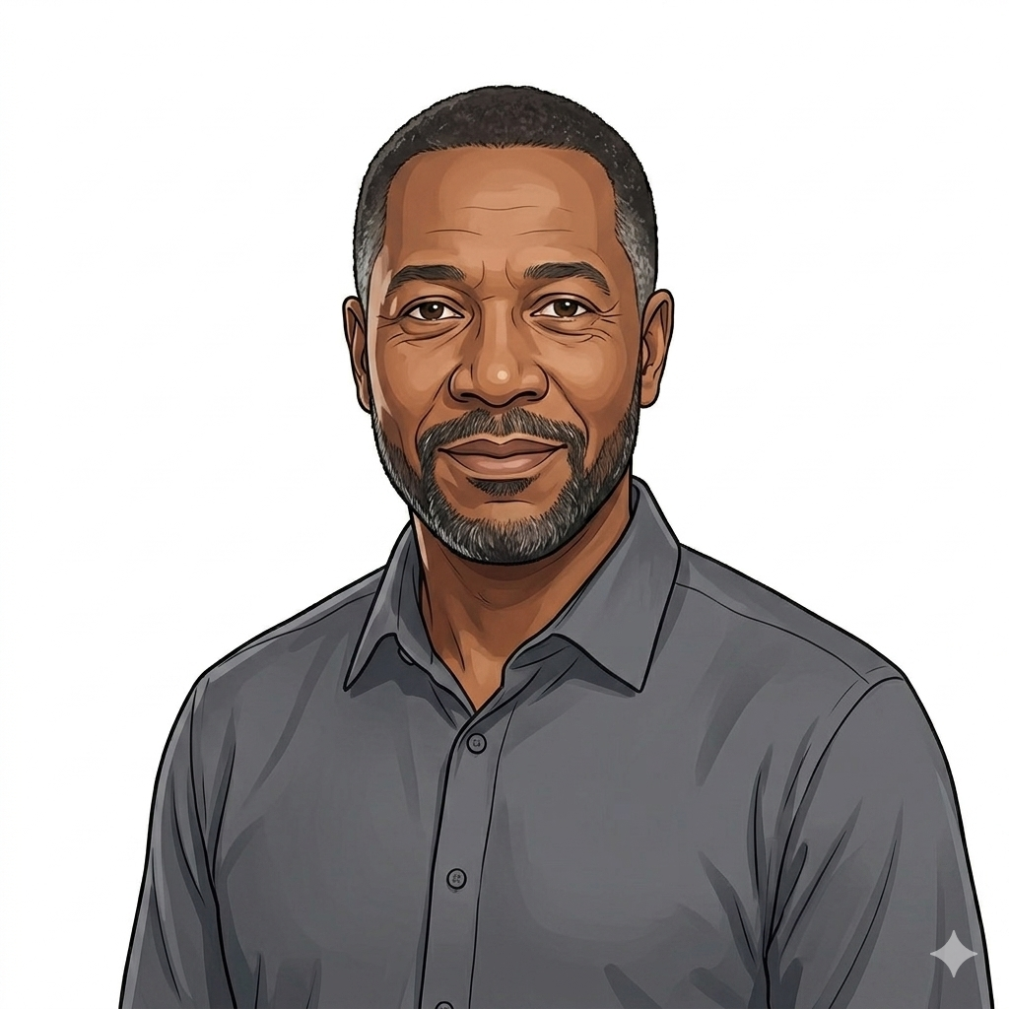
WHY THIS MATTERS FOR YOUR POPULATION
Errol is one of the patients in Sarah’s cohort. He never knew there was a procurement story behind his morning.
“I felt fine. The watch caught what I could not. The blood test confirmed what the data suggested. The digital therapeutic supported the response. And a crisis that should have happened did not happen.”
ERROL · 56 · THE PATIENT ON THE RECEIVING END OF THE FRAMEWORK
DTx Operating Model · Sales pack · Commissioner
6 of 12

Slide 7

WHY YOUR SUPPLIER BASE WILL ACTUALLY EXIST
A market with a real admission route is a market that attracts the suppliers you need to keep commissioning from.
“For four years we had the product, the evidence and the regulatory clearance. What we did not have was a national route in. The framework gave us one assurance pass, one contract instrument, and a national catalogue. Fourteen ICBs live in the time it used to take to negotiate one.”
MARCUS · DTX FOUNDER
DTx Operating Model · Sales pack · Commissioner
7 of 12

Slide 8
THE MODEL IN ONE SLIDE
What you call off against, and what you do not have to build.
Foundation
WHAT THIS MEANS FOR YOU
One framework, one assurance bar, one contract architecture, one MI feed
One national framework instrument carries three product overlays.
Supplier admission, clinical safety case, IG and assurance are done once at the centre. You consume the evidence pack, you do not reproduce it.
NHS Standard Contract with SaaS and data schedules carries the call-off across all three workstreams. NHS Commercial holds the framework above your contract.
One MI feed for supplier performance, cohort outcomes and financial discipline. Same data spine across HomeTest, HealthStore and HealthSync.
NICE EVA conditional recommendation route lets new configurations come onto the formulary against a real-world evidence generation commitment, not a five-year RCT delay.
Overlay
Per-product configuration: HomeTest, HealthStore, HealthSync
Pattern
Deployment shapes admitted under the framework
Configuration
The product-specific operating shape for each pathway
DTx Operating Model · Sales pack · Commissioner
8 of 12

Slide 9
TWELVE MONTHS ON
The board paper writes itself, because the framework has been generating the evidence for you.
Detection up. Admissions down. Cohort engagement holding. Suppliers performing against the same MI feed that fed Sarah’s monthly review.The evidence you generate locally feeds the next NICE re-evaluation, the next best-practice tariff, the next commissioner’s confidence in the framework you leaned on.Ongoing Evidence Generation at Foundation level threads the outcomes back into the Assurance Model. The flywheel runs once.
DTx Operating Model · Sales pack · Commissioner
9 of 12

Slide 10
THE ASK
Three ways to engage with the operating model from where you sit.
1
2
3
Adopt the framework for a real configuration
Pilot the next-wave configuration
Contribute to the model’s next layer
Pick a pathway in your population: CVKM detection, COPD self-management, high-risk monitoring. Call off against the framework. Six-week target from brief to call-off.
Configurations are admitted in waves. You can be the ICB that leads one. The framework adapts to what your population needs, not the other way round.
Commissioner-side representation on the framework governance is open. The Status page tracks the open decisions where ICB voices are needed.
DTx Operating Model · Sales pack · Commissioner
10 of 12

Slide 11
CLOSING
One commissioner. One signature. One year, not three.
Sarah is not commissioning three products. She is commissioning a population health response, with one framework taking the procurement, integration and assurance load off her team. The eighteen months she did not lose to procurement attrition is the eighteen months her patients did not spend waiting for the service to arrive.

Slide 12
Thank you
Operational detail, governance papers and the live model are available on request.
12 of 12

